Slide 1
Mid Semester Presentation
on
Industrial Timer Controller Using PLC System
SUBJECT CODE :- PRP-301
Session : July-December 2021
Presented By :-
Kurella Alekhya - 18BEM1020
Project Supervisor :-
Mr. Inderpreeet singh
Mechatronics Department
UIE-Department of Mechatronics Engineering

Slide 2
Contents
Introduction
Literature Review
Review Analysis and Research Gap
Project Objectives and Details
Experimental Setup/Procedure
Work Plan or Division/Timeline (By Each Team Member)
References
UIE-Department of Mechatronics Engineering

Slide 3
INTRODUCTION
The prime objective of this paper is to force the rider to control the multiple machine controlling to prevent sequence of motors and to enhance the operation of motor controlling based on industrial timer controlling
Thus the objective of this project is to controlling the motors with industrial timers
And This project will help the machine operator at their relevant timing with timer controlling
This project is having the concept of PLC controlling and industrial timer controlling through programming inside of the PLC and we can reduce the man power controlling also

Slide 4
Literature Review
Sr.No | Author(s) | Type/Title of study
1) | Dr. M.RAMA KRISHNA REDDY (1997) | “Electrical Utilization and Automation”
2) | John W. Webb and (2001) | “PLC AND ITS APPLICATIONS”
3) | Ronald A. Reis (1992) | “PLC PRINCIPLES AND ITS APPLICATIONS”
4) | Prof. Sunil S. Rao(1972) | “Switchgear Protection and Power Systems”
5) | Arun Ingole(2018) | “ Protection Devices and its Applications”
UIE-Department of Mechatronics Engineering

Slide 5
Research Gap
In previews all the operations is going to controlling by relay wiring technology
Industry is not having this micro controller based projects . All are Hard ware logic only ( RELAY WIRING TECHNOLOGY)
But day to day industry has updating into Automation technology
Even our Project is also relevant to industrial automation and we are developing ladder programming and implementing operating techniques to industry by using industrial timer controlling
In Previews there is no such type of controlling in our industry by relevant this industrial timer controlling system a
This project is easy to set our timing in timer and controlling machines according SOP (standard operating procedure )

Slide 6
Project Objectives & Details
An automated machine is increased in this globalised world. This project outlines the timer controller for multiple machines
Objective of this project is to controlling the machine through a industrial timer and reduce the complexity to control machine on time base
We are using a industrial ON DELAY timer and we are going to set a timing in timer according to our requirement
And completion of delay timer timer will give a relay feedback to our PLC controller
In PLC we need to write a program according machine machine sequence requirement and we need develop a program in PLC through ladder logic program
When u will get feed back from Timer automatically machine s is going to running according sequence

Slide 7
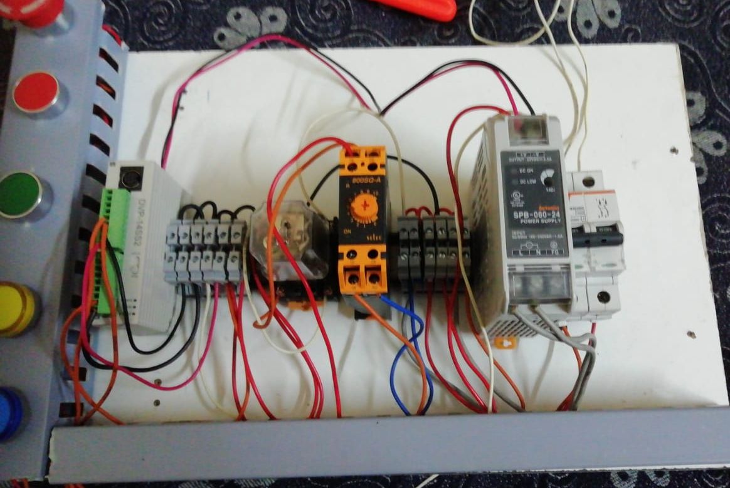
Experimental Setup

Slide 8
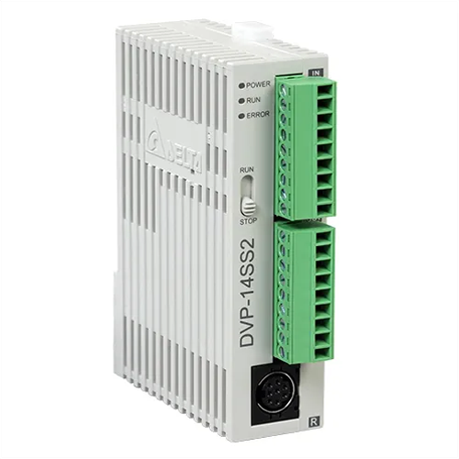
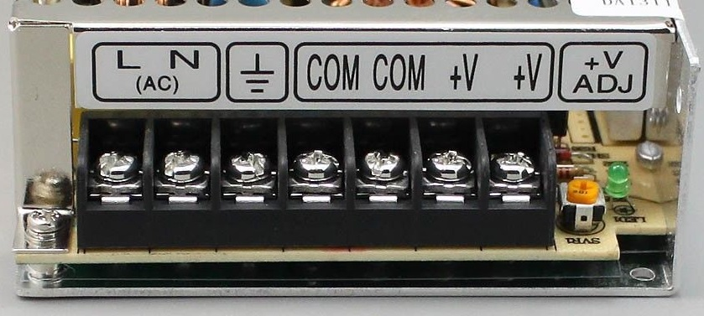
Components
2 POLE MCB
Programmable Logic Controller
Switch Mode Power Supply
PVC channel
PVC caps
Din Rail
Industrial timer
Motor indication lamp
On/off button
Emergency Button
Indication lamps
Wiring accessories
3 pin plug

Slide 9
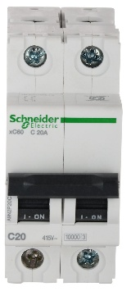
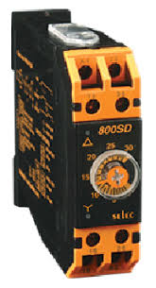
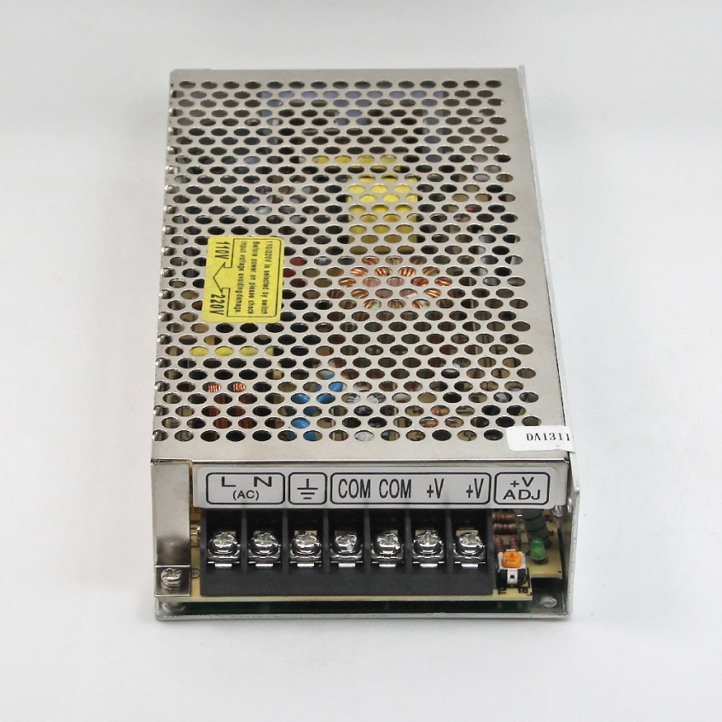
Components
2 pole MCB | 6 amps
SMPS | 24 VDC
Recommended Input voltage to PLC | 24 VDC
Recommended Input voltage to SMPS | 230 VAC
PVC channel | 40 MM
DIN RAIL | 30 MM
ON BUTTONE | NO
OFF BUTTONE | NO
EMERGENCY BUTTONE | NC
MOTOR INDICATION LAMPS | 24VDC LAMPS
3 pin plug | For 230v supply
Wiring Accessories | REPUTED

Slide 10
Reference
AzuraCheSoh/LaiGuanRhung―MATLABSimulationofFuzzyTraffic ControllerforMultilaneIsolatedIntersection‖www.enggjournals.com/ijcse/doc/IJCSE10-02-04-11.pdf
Monica Voinescu, AndreeaUdrea, SimonaCaramihal―On Urban Traffic ModellingandControl‖http://www.ceai.srait.ro/index.php/ceai/article/view/307
C.M.Mwangi,S.M.Kang‘etheandG.N.Nyakoe―Designandsimulation ofafuzzylogictrafficsignalcontrollerforasignalizedintersection‖elearning.jkuat.ac.ke/journals/ojs/index.php/jscp/article/view/699
Ovidiu TOMESCU, IlonaMadalina MOISE, Alina Elena STANCIU, IulianBĂŢROŞ ―Adaptive Traffic Light Control System using ADHOC Vehicular CommunicationsNetwork‖www.scientificbulletin.upb.ro/rev_docs_arhiva/full6a2_686823.pdf

Slide 11
THANK YOU !

